Slide 1
Food Logging System
________________________________________________________________
COMP5427 Usability Engineering
Tutor: Thushan Ganegedara
Group: 1

Slide 2
Design Overview
Take into account the key lessons from our initial log
Minimalist and Ease of Use
Simplicity but provide enough instructions
Intuitiveness
Timeline and Categorization
Easy to browse
Keep things in group
Knowledge about Quantity
Provide assistance ( how to estimate a serve size)
Recommended serves for the user
User’s performance
Visualization
Graphical views = quick interpretation

Slide 3
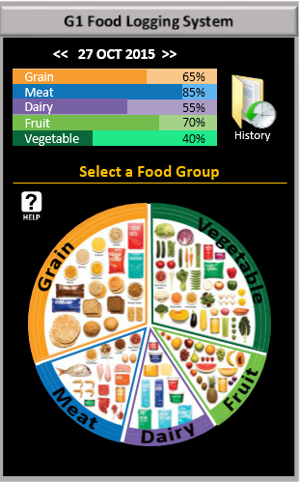
Design Overview
Final Design
Minimalist Design
Clear Instruction
Assistance
Visualization
Graphs
Symbols
Images
Prime Pixels

Slide 4
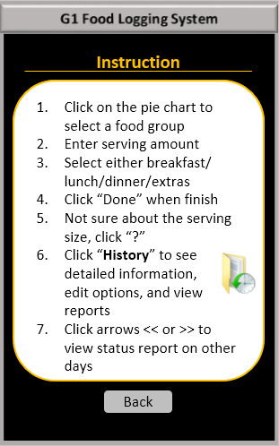
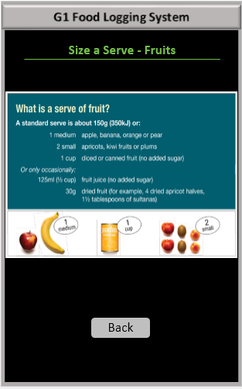
Design Overview
Final Design
Consistent Format
Clear Instructions
Consistency

Slide 5
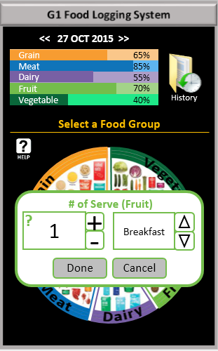
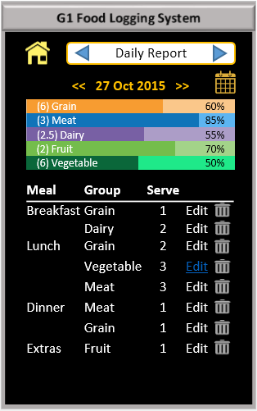
Design Overview
Final Design
Intuitive
Simplicity
Help
Intuitive
Categorization

Slide 6
Cognitive Walkthrough
Task 1: You recall that you ate 1 serve of fruit today. Log that.
Assumption: The user’s profile has been set up.
0. will user understand this sub-task is needed
a. Select ‘Fruit’ section
b. Enter the number and select meal type (breakfast/lunch/dinner/extras)
c. Click ‘Done’ when finish

Slide 7
Cognitive Walkthrough
Task 1: You recall that you ate 1 serve of fruit today. Log that.
Sub-Task: a. Select ‘Fruit’ section
1. will correct action be obvious?
Click on the pie chart to select ‘Fruit’
= Yes, pie chart is clearly displayed with images and text.
2. will user understand instructions?
= Yes, title labelled “Select a Food Group”
3. will user know if progress has been made?
= Yes, a dialog pops up

Slide 8
Cognitive Walkthrough
Task 1: You recall that you ate 1 serve of fruit today. Log that.
Sub-Task: b. Enter the number and select meal type (breakfast/lunch/dinner/extras)
1. will correct action be obvious?
Type or use +/- to select a number, use up/down arrow to select meal type
= Yes, dialog clearly displayed with symbols
2. will user understand instructions?
= Yes, “?” helps users to estimate serving size
3. will user know if progress has been made?
= Yes, number and meal type changed accordingly

Slide 9
Cognitive Walkthrough
Task 1: You recall that you ate 1 serve of fruit today. Log that.
Sub-Task: c. Click ‘Done’ when finish
1. will correct action be obvious?
Click done/cancel
= Yes, buttons are self-explained
2. will user understand instructions?
= Yes, buttons are self-explained
3. will user know if progress has been made?
= Yes, dialog disappears. The bar graph and percentage change.

Slide 10
Cognitive Walkthrough
Task 3: You realise that was a mistake and you actually ate only 2 serves of vegetables. Update the logger for that.
Assumption: The user’s profile has been set up.
0. will user understand this sub-task is needed
a. Go to “History”
b. Click “Edit” for the item that needs to be updated
c. Change the number
d. Click “Done"

Slide 11
Cognitive Walkthrough
Task 3: You realise that was a mistake and you actually ate only 2 serves of vegetables. Update the logger for that.
Sub-Task: a. Go to “History”
1. will correct action be obvious?
= Yes, the term ‘History’ is an obvious link to all recorded items.
2. will user understand instructions?
= Yes, the term is self-explained. “Help” can also provide the instruction.
3. will user know if progress has been made?
= Yes, user is directed to a new page.

Slide 12
Cognitive Walkthrough
Task 3: You realise that was a mistake and you actually ate only 2 serves of vegetables. Update the logger for that.
Sub-Task: b. Click “Edit” for the item that needs to be updated
1. will correct action be obvious?
= Yes, the log is clearly displayed with Edit link.
2. will user understand instructions?
= Yes, “Edit” button is dedicated for each item
3. will user know if progress has been made?
= Yes, once ‘Edit’ is clicked, a dialog is shown

Slide 13
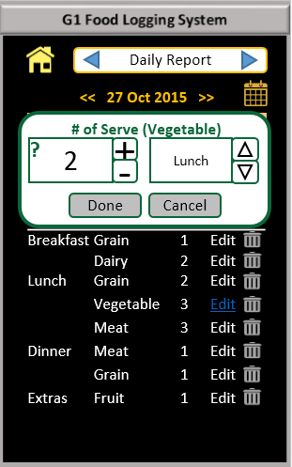
Cognitive Walkthrough
Task 3: You realise that was a mistake and you actually ate only 2 serves of vegetables. Update the logger for that.
Sub-Task: c. Change the number
1. will correct action be obvious?
= Yes, the same pop-up dialog appears upon a click.
2. will user understand instructions?
= Yes, the pop-up dialog has the same appearance/symbols
3. will user know if progress has been made?
= Yes, number and meal type changed accordingly

Slide 14
Cognitive Walkthrough
Task 3: You realise that was a mistake and you actually ate only 2 serves of vegetables. Update the logger for that.
Sub-Task: d. Click “Done"
1. will correct action be obvious?
= Yes, buttons are self-explained.
2. will user understand instructions?
= Yes, buttons are self-explained.
3. will user know if progress has been made?
= Yes, once ‘Done’ is clicked, the dialog disappears. The number of serve changes.

Slide 15
Cognitive Walkthrough
Strengths:
Good balance between minimalist and clear instructions
Use of symbols where appropriate
Provide useful information, in terms of report variety (day, week, month)
System status and progress are clearly indicated
Flexibility and Controllability provided to users for browsing and making any changes/updates
Use of images help users to recognize food group more easily
Coloured graphs offer a quick visualization of user’s performance

Slide 16
Cognitive Walkthrough
Weaknesses:
System only allows logging of 5 food groups. Other types of intakes, such as drinks or discretionary, cannot be logged.
No calendar to help browsing to a specific date when logging
Unable to add more items for any date via the “Daily Report” page.
Limited types of food to provide examples when estimating a serving size in “Size a Serve” page.
Precooked meal, such as hamburger or pasta, may be considerably difficult to break down into groups.
Users need to be familiar with serving size.
No system reminder.

Slide 17
Think-Aloud Evaluation
Summary of relevant information about the users:
18 – 34 years old
Good mix of genders
Most are students
Medium to high computer skills
Background | P1 | P2 | P3 | P4 | P5
Age | 22 | 34 | 29 | 18 | 24
Gender | Female | Male | Female | Female | Male
Occupation | Student | Manager | Accountant | Student | Student
Computer Literacy | High | Medium | Medium | Medium | High

Slide 18
Think-Aloud Evaluation
USER 1 - Summary of Observations
 | Task 1 | Task 2 | Task 3
Success | Yes | Yes | Yes
Time | 50s | 15s | 40s
Observations | The user firstly look into Instruction, then click fruit group pie chart based on instruction. Next, the user adjust the numbers of serves into 1. Finally clicking "done". | The user click vegetable group and adjust the numbers of serves into 3. Then click "Done". | First of all, the user click on "History" and the food that the user logged is displayed on the screen. click on "Edit" button, and adjust the numbers of serves into 2. Finally click "Done".
Errors | No | No | No
User’s comments | Very easy under the instructions. | The same operation with the first task. | All information they need is displayed on the screen. The information is useful and the navigation is clearly.
The user can easily complete all three tasks in a short time. There is no errors during the user perform these tasks, because she read carefully all instructions before she preform the tasks.

Slide 19
Think-Aloud Evaluation
USER 2 - Summary of Observations
 | Task 1 | Task 2 | Task 3
Success | Yes | Yes | Yes
Time | 20s | 7s | 15s
Observations | The user looks at the pie chart and clicks on "Fruit" section. Then he changes the serve number, but couldn't find where to change the date. Then, he realizes the date up top, and proceeds by clicking "Done" | Perform the task quickly. | The user tries clicking on the graph, but nothing happens. Then, he sees the history, clicks, and finds the logged information. He searches through the log and finds vegetable item. He clicks on "edit" and changes the number.
Errors | - | - | Trying to click on the graph.
User’s comments | The date should be located close to the pie chart. It also could be better if a calendar is implemented for a faster way to select any date. | - | The history is clearly displayed, but he just didn't notice it.
The user complete all tasks very quickly. He just simply click buttons that he need. One error that made by him is that he click on the graph rather than the "History". Once he found the "History" button, he can easily finish the task.

Slide 20
Think-Aloud Evaluation
USER 3 - Summary of Observations
 | Task 1 | Task 2 | Task 3
Success | Yes | Yes | Yes
Time | 40s | 20s | 1m 15s
Observations | Looking for fruit items. User doesn’t know if bf, lunch or dinner. | Very quick. Similar procedure than task 1 | User clicked vegetable option. Then, try to find an update option. Came back to main page. User used help option.
Errors | - | -
User’s comments | Very easy and interactive | No problems | The history button is not very intuitive in order to update an item.
All tasks can be successfully performed by the user. For the first two task, the users can finish them very easily without any problems. When the user preform the third task, he click on "Help" to help him complete the task.

Slide 21
Think-Aloud Evaluation
USER 4 - Summary of Observations
 | Task 1 | Task 2 | Task 3
Success | Yes | Yes | Yes
Time | 16s | 9s | 36s
Observations | The user did the logging through the pie chart after some error operation. | The user quickly did the logging through the pie chart | The user was not sure about where to click, so she clicked the help button, and read closely until she found instructions on task 3. And then successfully completed the task.
Errors | The user tried to click at the spreadsheet at first. | No | No
User’s comments | It could better if the instruction is "select a food group to log" | Pretty easy, because it is basically the same with Task 1. | The help information is useful.
The user can complete all tasks in the case of relying on the help information and has some suggestions for the help.

Slide 22
Think-Aloud Evaluation
USER 5 - Summary of Observations
 | Task 1 | Task 2 | Task 3
Success | Yes | Yes | Yes
Time | 30s | 15s | 30s
Observations | The user skipped the Instruction at the first time and then go back through help. After spending a few seconds to read it, the task is done quickly. | Easy and quick. | The user go back and check the instruction again and then finished the task without problem.
Errors | N/A | N/A | N/A
User’s comments | Instruction is too long to be read totally. | Easy | instruction looks not perfect.
The user can finish all tasks properly and the only problem with him is that the instruction seems not so friendly and might make the experience slightly worse.

Slide 23
Think-Aloud Evaluation
Summary of Key Problems Identified
The history button is not so intuitive for updating records.
The interface of instruction is not perfectly user-friendly
“Size a serve” button is not easy to figure out in the number of serves field. Its size and location is not so intuitive for user experience.
There is no changes or process status when user enter a new record.

Slide 24
Think-Aloud Evaluation
Critique of the Work
The demographics of participants for think-aloud tasks do not has good coverage. The age range only covers 18 to 34. In addition, none of the participants has low computer literacy.
Further TA tests for a wide number of users and with different background (range of age or computer literacy), would allow us to can get other problems and comments about the user experience and their usability.

Slide 25
SUS Questionnaire
 | Questions | P1 | P2 | P3 | P4 | P5
1 | I think that I would like to use this system frequently. | 3 | 2 | 3 | 3 | 2
2 | I found the system unnecessarily complex. | 2 | 2 | 4 | 2 | 3
3 | I thought the system was easy to use. | 4 | 2 | 3 | 3 | 3
4 | I think that I would need the support of a technical person to be able to use this system. | 3 | 4 | 1 | 3 | 4
5 | I found the various functions in this system were well integrated. | 4 | 2 | 3 | 3 | 3
6 | I thought there was too much inconsistency in this system. | 2 | 3 | 3 | 4 | 4
7 | I would imagine that most people would learn to use this system very quickly. | 3 | 2 | 2 | 3 | 3
8 | I found the system very cumbersome (*awkward) to use. | 1 | 3 | 3 | 3 | 3
9 | I felt very confident using the system. | 3 | 2 | 3 | 3 | 4
10 | I needed to learn a lot of things before I could get going with this system. | 3 | 4 | 2 | 2 | 4
 | Grand total | 67.5 | 65 | 67.5 | 72.5 | 82.5

Slide 26
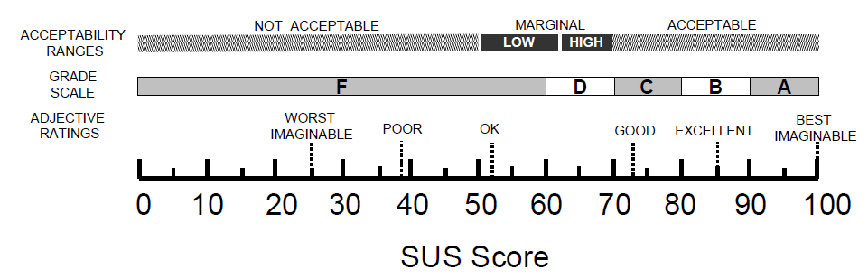
SUS Questionnaire
Key Conclusions:
The median value for five participants in this questionnaire is 67.5 and the average is 71, slightly bigger than the median score. Using an adjective rating scale (Bangor, 2009) and matching the corresponding SUS scores given by participants, the results are as following:
Participant | SUS Score | Adjective Rating Scale
1 | 67.5 | Good
2 | 65 | Good
3 | 67.5 | Good
4 | 72.5 | Good
5 | 82.5 | Excellent
Average | 71 | Good
Average

Slide 27
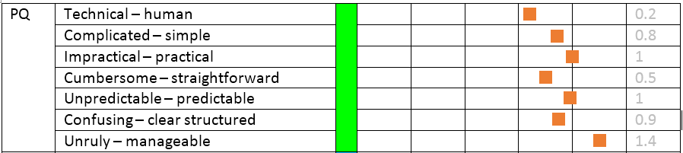
AttrakDiff Questionnaire
Pragmatic Quality (PQ):
The average score for PQ is 0.829, showing that the overall pragmatic quality of our system is very good. The highest average score within this part is 1.4, indicating the system is much more “manageable” than “unruly”. The lowest average score within this part is 0.2, indicating the system is more “human” than “technical”.

Slide 28
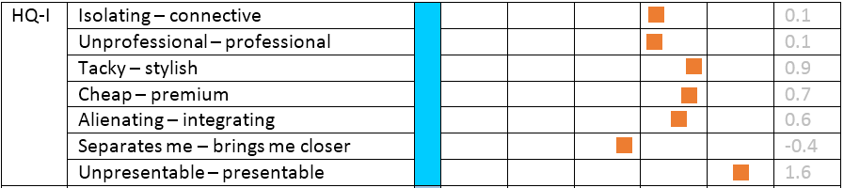
AttrakDiff Questionnaire
Hedonic quality - Identity (HQ-I):
The average score of HQ-I is 0.514, showing that the hedonic quality of our system on identity of our system is good. The highest average score within this part is 1.6, indicating the system is much more “stylish” than “tacky”. The lowest average score within this part is -0.4, indicating the system is more “separates me” than “brings me closer”.

Slide 29
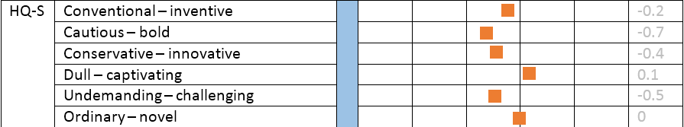
AttrakDiff Questionnaire
Hedonic quality - stimulation (HQ-S):
The average score for PQ is -0.283, showing that our system did not do well in hedonic quality of our system on stimulation. The highest average score within this part is 0.1, indicating the system is little bit more “captivating” than “dull”. The lowest average score within this part is -0.7, indicating the system is much more “cautious” than “bold”.

Slide 30
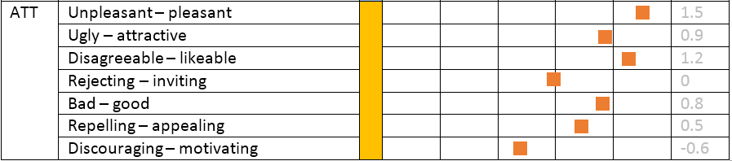
AttrakDiff Questionnaire
Attractiveness (ATT):
The average score for ATT is 0.467, showing that the overall attractiveness of our system is okay. The highest average score within this part is 1.2, indicating the system appears much more “pleasant” than “unpleasant”. The lowest average score within this part is -0.6, indicating the system is less “motivating” than “discouraging”.

Slide 31
Summary of Questionnaires
In general, both questionnaires show positive results. SUS questionnaire gave a broad view of the user experience for our prototype. Its result indicates good user acceptance and an easy way to realize what the user perspective is.
On the other hand, AttrakDiff questionnaire gives a more specific user perception and more neutral user feedback. Pragmatic Quality (PQ), Identity (HQ-I) and Attractiveness (ATT) all reflects user’s acceptance with positive feedback; however, Stimulation (HQ-S) rates are slightly below 0 mark, indicating that our system is more cautious and conservative than innovative and bold.

Slide 32

Thank You

